Slide 1




Introduction to Quantum Computing
Quantum computing is an advanced computing approach that leverages the principles of quantum mechanics. Unlike traditional computers, quantum computers utilize quantum bits or qubits, which can exist simultaneously in multiple states. This enables them to solve complex problems that are impossible for classical computers.
by Natnael Sisay

Slide 2
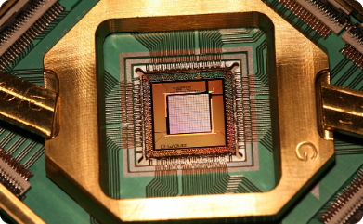
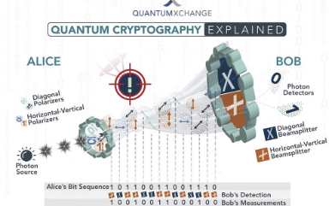
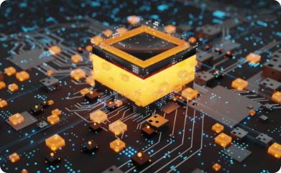
Advantages of Quantum Computing
Enhanced Computational Power
Unprecedented Security Measures
Complex Problem Solving
Quantum computers have the potential to exponentially increase computational capabilities, revolutionizing fields like cryptography and material science.
Quantum computing offers highly secure encryption methods due to its ability to process vast amounts of data at an unparalleled speed.
Quantum computing enables the processing of complex calculations at an accelerated rate, benefiting various industries such as drug discovery and weather forecasting.

Slide 3
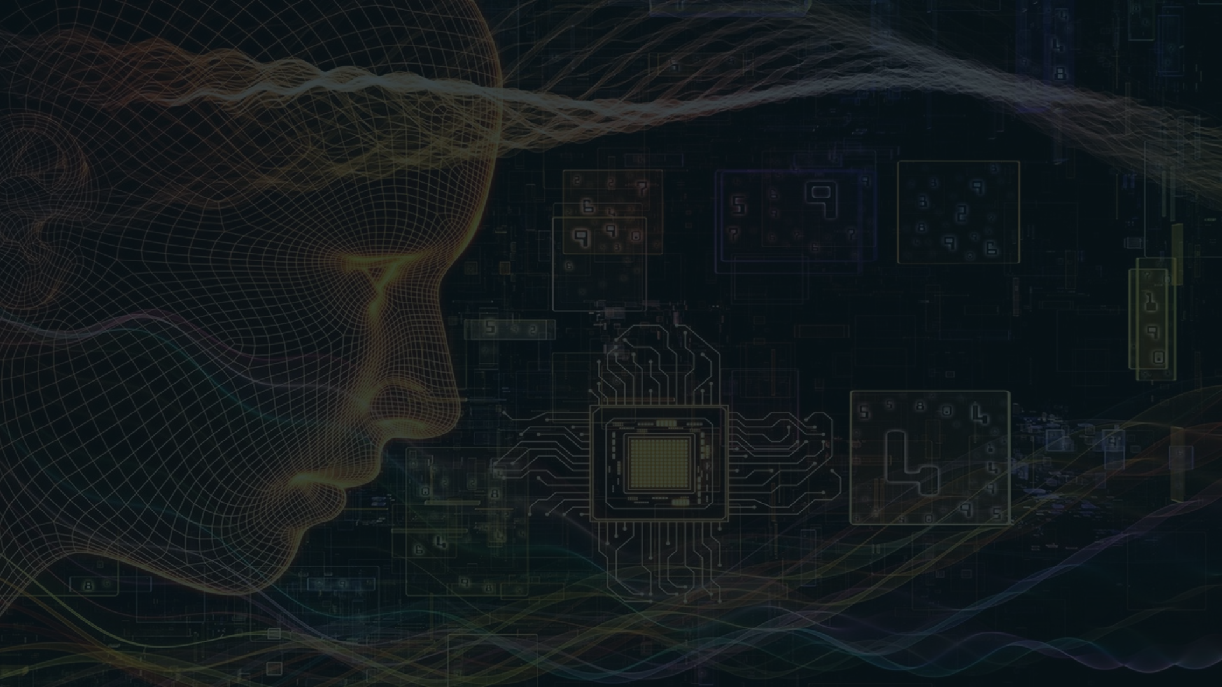
Conclusion
Future-Proof Technology
Scientific Advancements
Global Impact
The advent of quantum computing has the potential to bring about transformational changes in industries, opening doors to unparalleled advancements in technology.
Quantum computing is poised to redefine the technological landscape, offering solutions to challenges that were, until now, insurmountable.
With its potential to unlock new scientific breakthroughs, quantum computing presents a gateway to innovation across various scientific disciplines.

